Slide 1

Sales Strategy & Growth Plan (2018)
Our 2018 strategy is meticulously crafted to drive significant revenue growth, optimize profit margins, and sharpen our focus on top-performing regions and products. This plan sets the foundation for a prosperous year ahead.
Increase Revenue
Improve Profit Margins
Focus on High-Performers
Expand market share and boost sales volume.
Enhance profitability through strategic product and regional focus.
Prioritize regions and products with proven high performance.

Slide 2
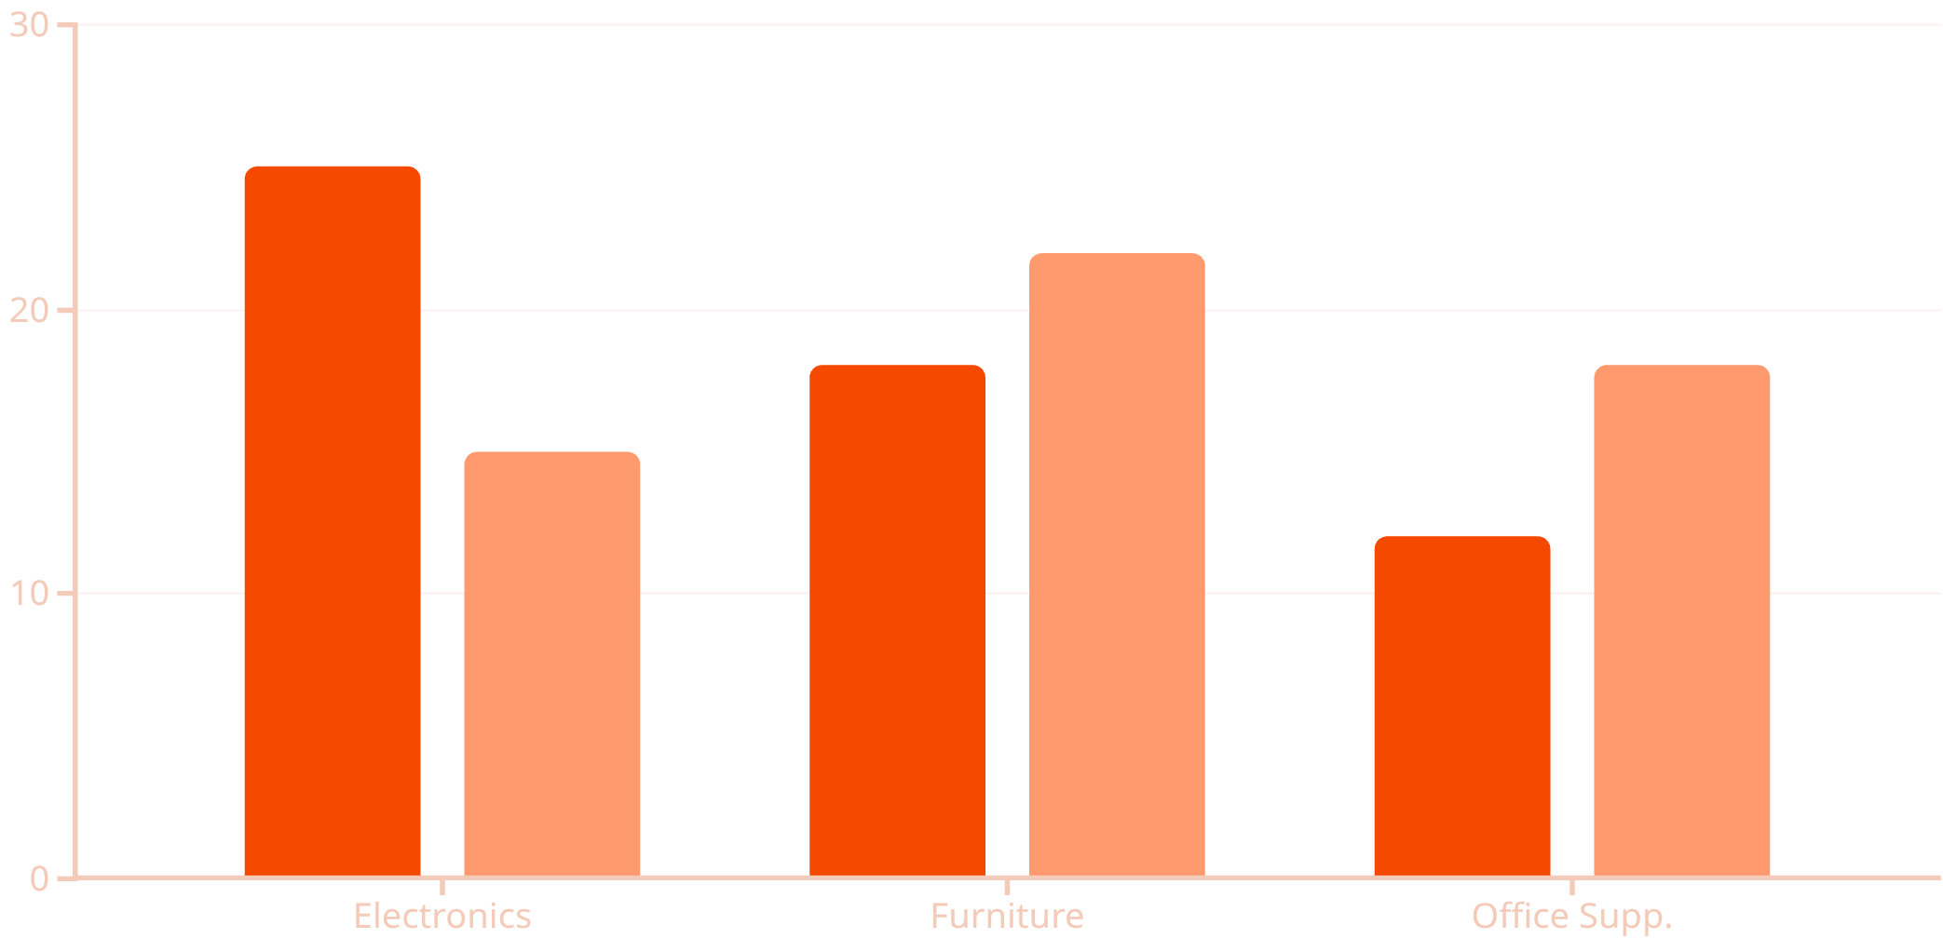
Sales Performance Overview: Electronics & Profitability
Analyzing our sales data, Electronics stands out as our primary revenue driver. While it contributes significantly to our top line, a deeper dive reveals a critical insight: high sales volume does not always equate to high profit margins.
This understanding necessitates a strategic shift towards a profit-first sales approach. We must identify and prioritize products and categories that not only sell well but also deliver substantial bottom-line impact. This targeted strategy will ensure sustainable growth and maximized profitability across our portfolio.
Revenue (Millions)
Profit Margin (%)

Slide 3

Optimizing Our Product Strategy for Profitability
To achieve our profit-first sales objective, we are refining our product strategy. This involves a clear prioritization of high-margin items and a critical review of underperforming categories.
High Priority Products
Focus our sales and marketing efforts on these categories for maximum impact:
Electronics: Specifically, high-end Phones and advanced Printers.
Furniture: Premium Chairs known for durability and design.
Products Under Review
Evaluate and strategize on these categories to either improve profitability or consider discontinuation:
Bookcases: Assess market demand and cost efficiency.
Low-margin electronics: Identify specific items with unfavorable profit margins and develop mitigation plans.

Slide 4
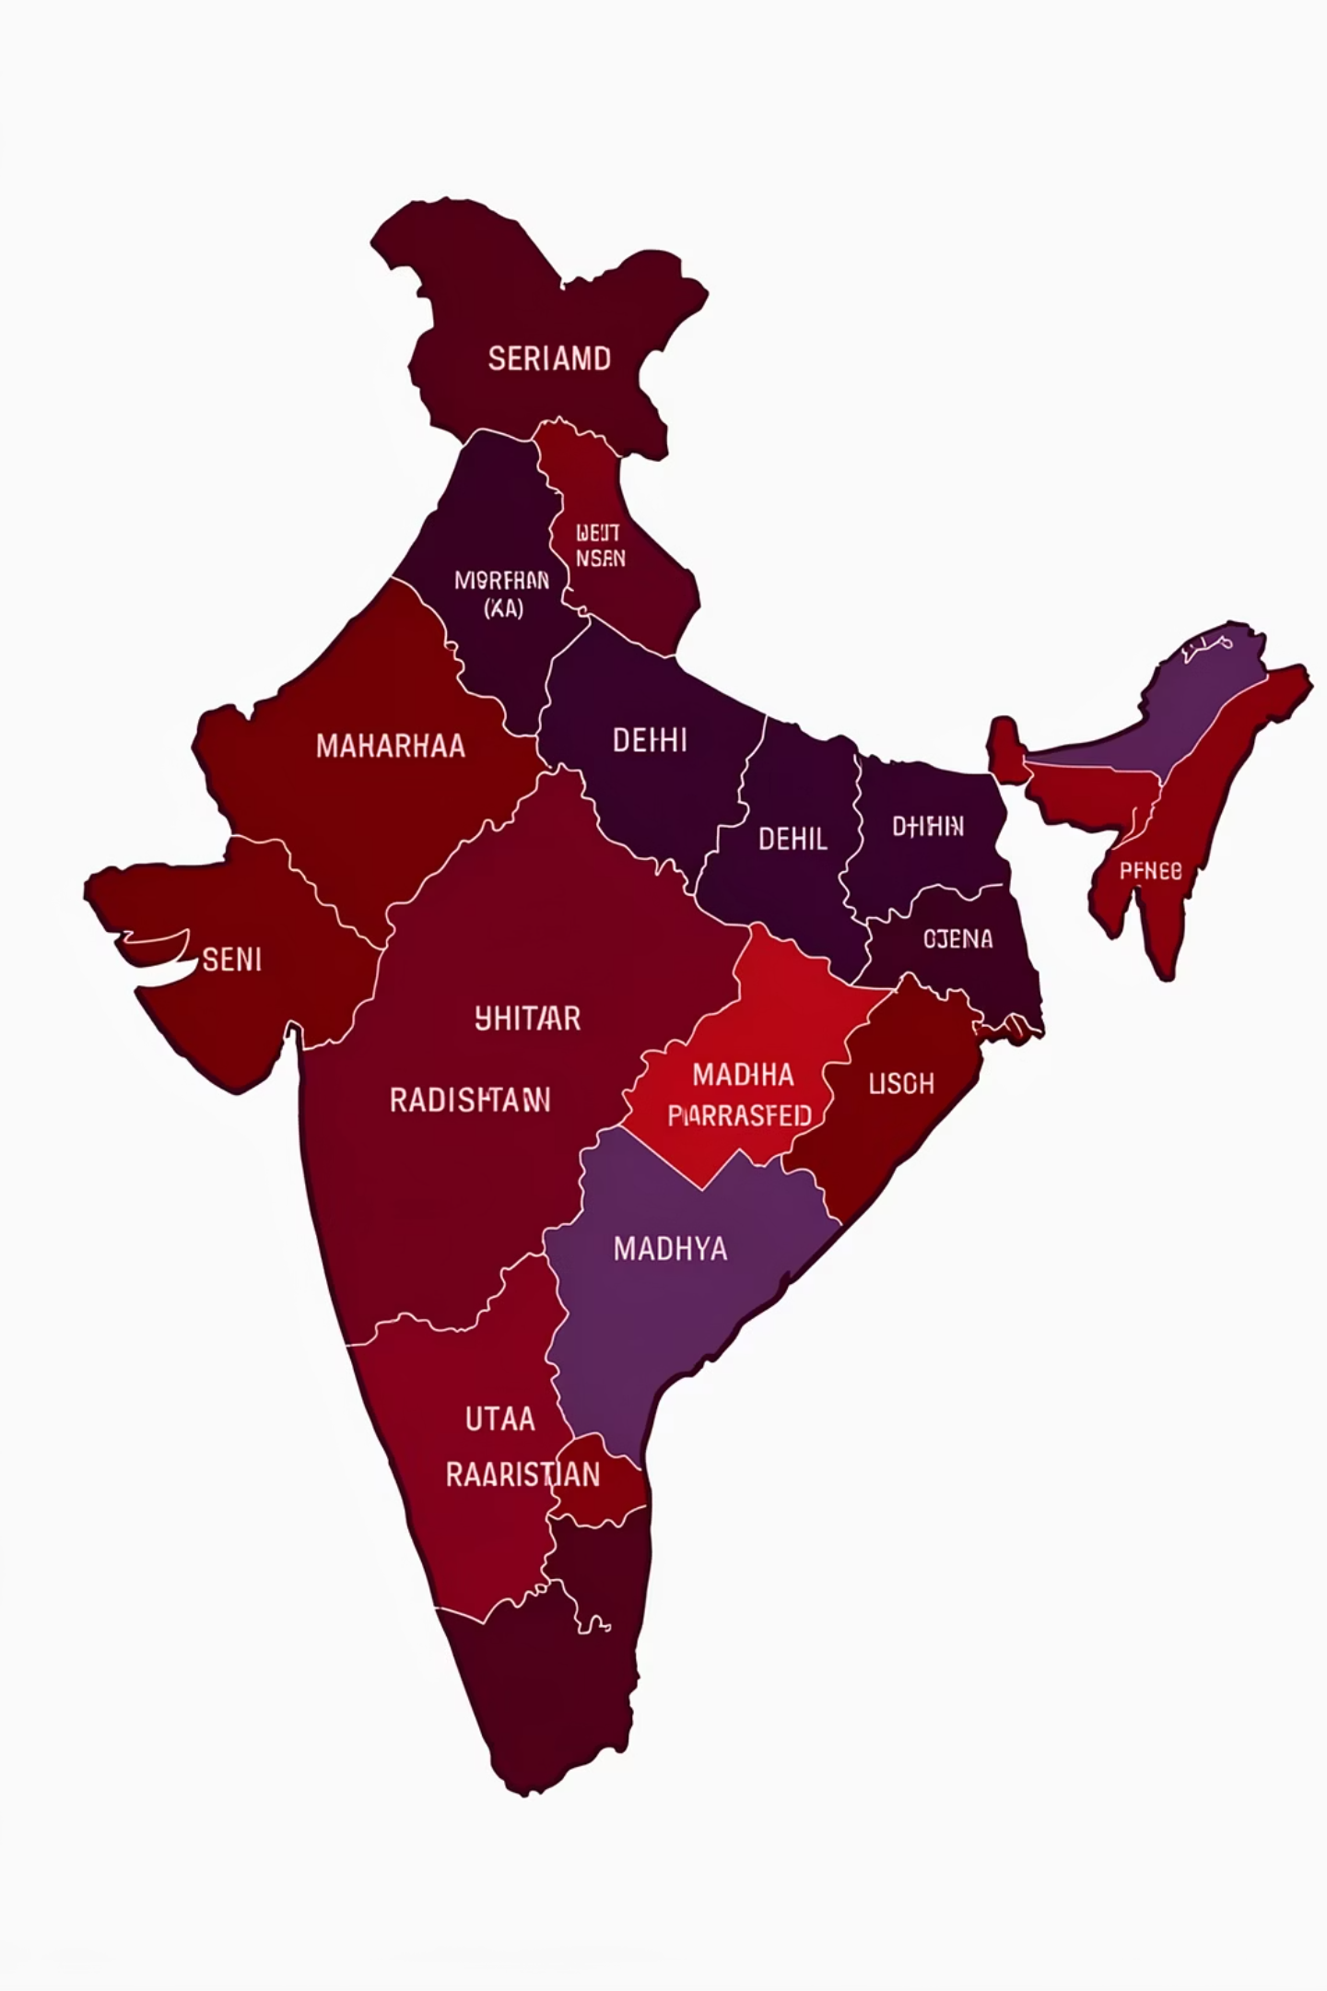

Strategic Regional Growth: Targeting Key Markets
Our regional growth strategy is centered on maximizing presence and performance in our strongest markets while cultivating emerging opportunities. This geographical focus ensures efficient resource allocation and tailored approaches for each region.
Top Performing Markets
These regions have consistently delivered strong sales and will be integral to our core strategy. We will continue to invest and deepen our market penetration here.
Maharashtra
Delhi
Uttar Pradesh
High-Potential Growth Areas
These markets show significant potential for expansion and will be targeted for strategic development initiatives. Focused campaigns and increased sales presence are planned.
Rajasthan
Madhya Pradesh

Slide 5
Enhancing Customer Experience Through Payment & Loyalty Strategies
Our payment and customer retention strategies are designed to boost order values and foster long-term loyalty. By understanding customer payment preferences, we can strategically influence purchase behavior and reinforce relationships.
EMI & Credit Card Options
Cash on Delivery (COD) Considerations
Customer Loyalty Programs
Promoting Equated Monthly Installments (EMI) and Credit Card payments has shown to significantly increase average order values, making higher-priced items more accessible to customers.
While Cash on Delivery (COD) remains a popular option, it often correlates with lower profit margins due to operational costs and potential returns. We will strategically manage its offering.
Implementing robust loyalty programs is crucial for encouraging repeat purchases and building a strong, committed customer base, driving sustained long-term revenue.

Slide 6
Final Recommendations & Impact: Driving Sustainable Growth
By integrating these strategic recommendations, we anticipate a transformative impact on our business performance, leading to both immediate gains and sustained profitability. Our focus is clear, and our actions are targeted.
01
02
Prioritize High-Margin Products
Tailor Regional Offers
Shift focus to products like premium electronics and furniture to maximize individual transaction profitability.
Develop customized strategies for top-performing and high-growth regions, considering local demand and competitive landscapes.
03
04
Optimize Payment Incentives
Cultivate Customer Loyalty
Leverage EMI and credit card promotions to increase average order values and customer spending.
Invest in loyalty programs to encourage repeat business and strengthen customer relationships.
Expected Outcome: Significantly Higher Revenue & Enhanced Profit Margins
These focused efforts are projected to not only increase our overall revenue but also substantially improve our profit margins, ensuring a stronger, more resilient financial standing for 2018 and beyond.

